Slide 1
Lecture 11 Storing and using Bitcoins

Slide 2
Purchasing Bitcoins

Slide 3
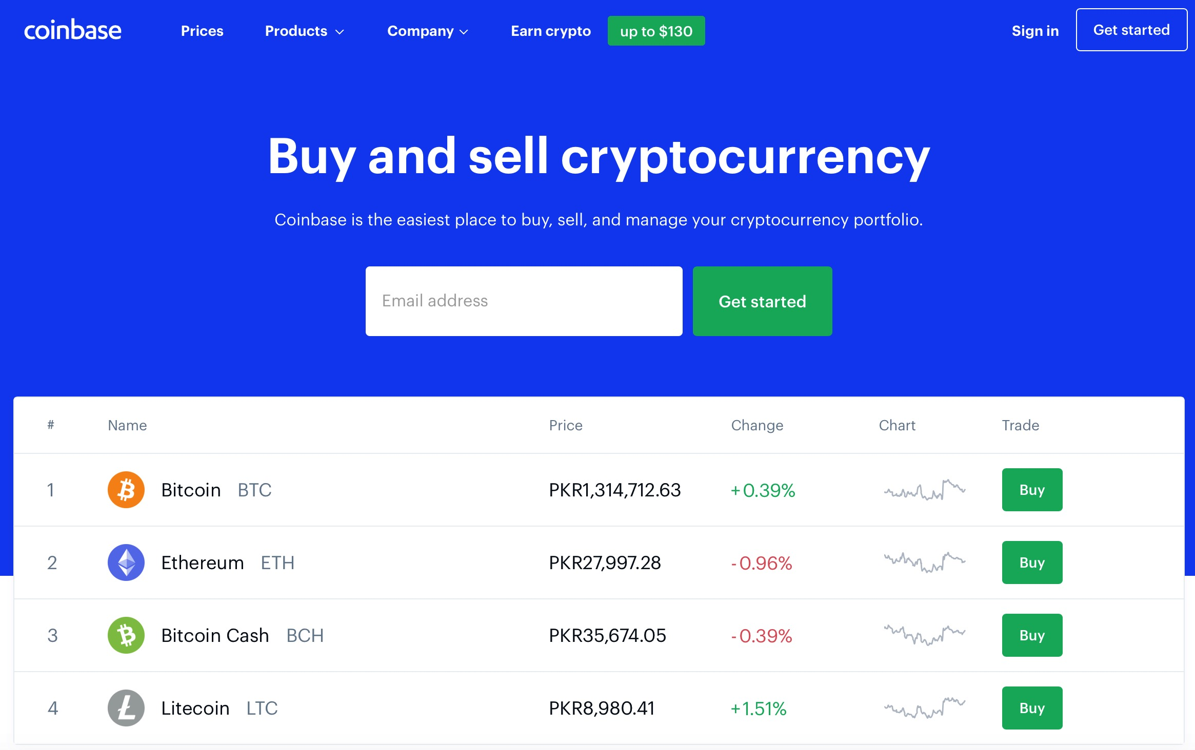
Purchasing Bitcoins

Slide 4
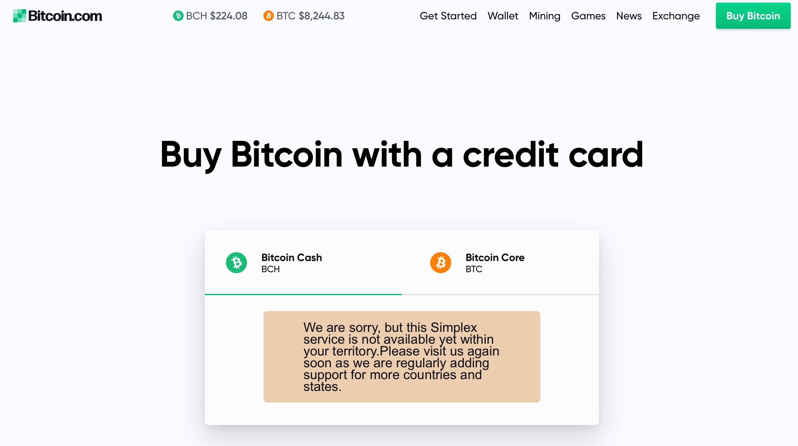
Purchasing Bitcoins

Slide 5
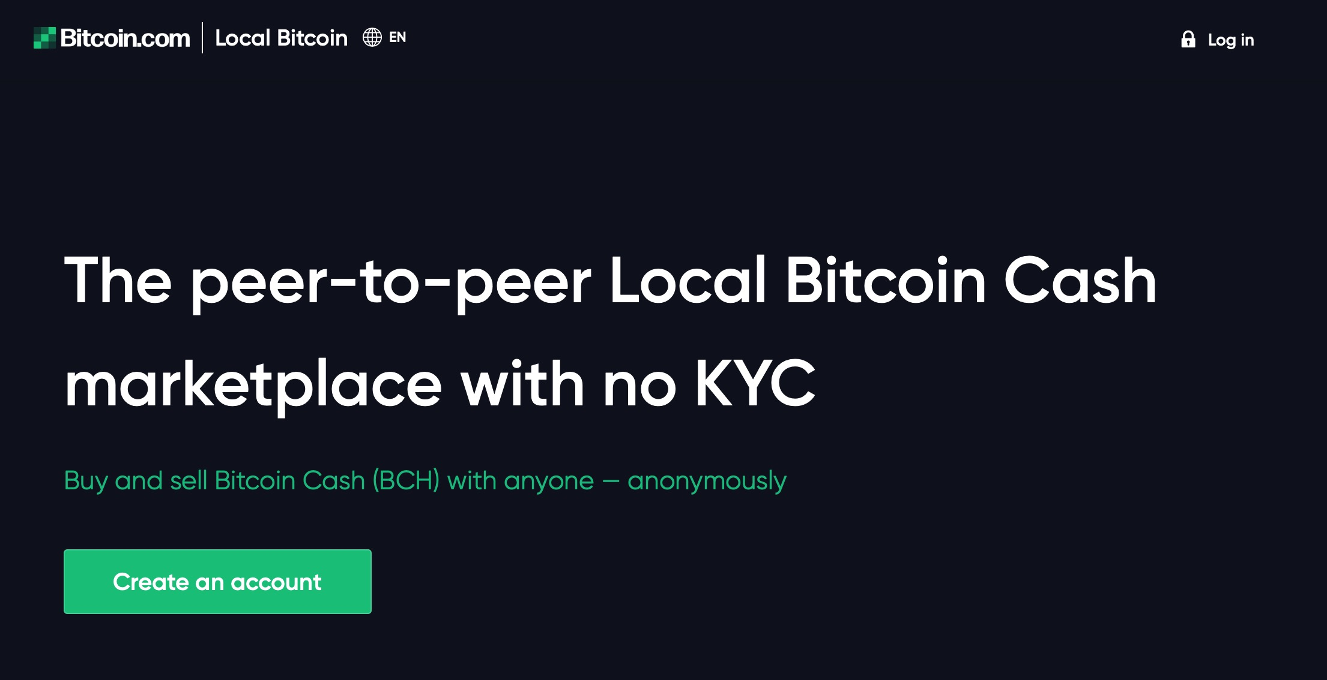
Purchasing Bitcoins

Slide 6
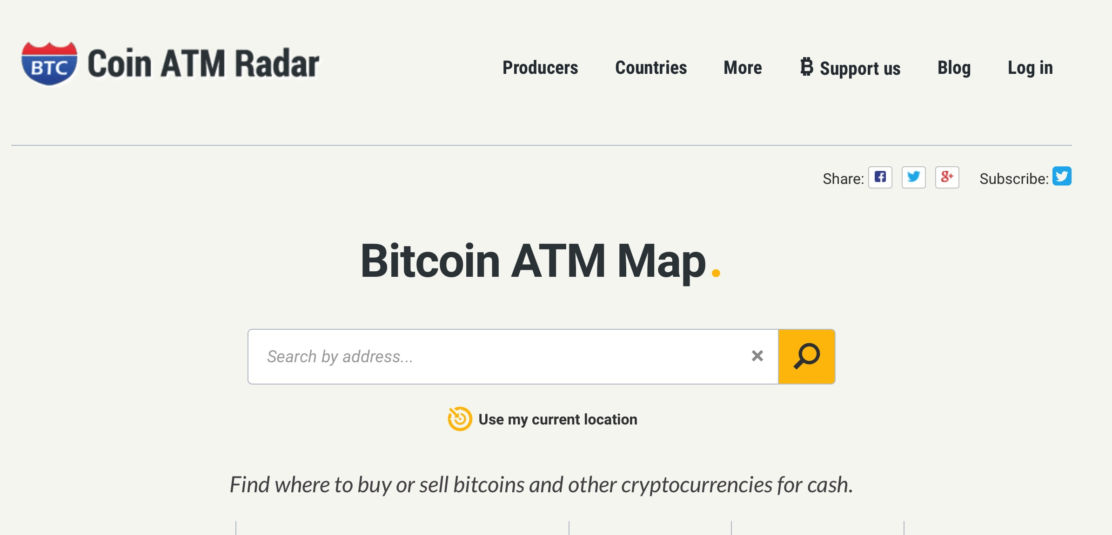
Purchasing Bitcoins

Slide 7
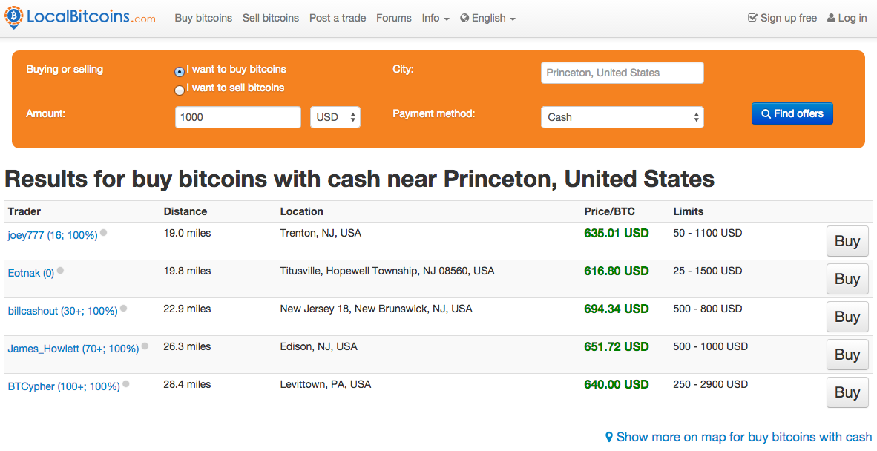

Slide 8


Slide 9
Storing Bitcoins - Simple Local Storage

Slide 10
Key Management
To spend a Bitcoin, you need to know some public and some private information
The public information is what goes on the block chain — the identity of the coin, how much it's worth, and so on.
The secret information is the secret key of the owner of the bitcoin, presumably, that’s you.
So it’s all about key management.

Slide 11
How to Store and Use Bitcoins
Secret Keys

Slide 12
Goals
Availability: You can spend your coins.
Security: Nobody else can spend your coins.
Convenience - Do you remember that incident about keys in the email draft?

Slide 13
Keys Management
Simplest approach: store key in a file, on your computer or phone
Very convenient.
As available as your device. device lost/wiped ⇒ key lost ⇒ coins lost
As secure as your device - device compromised ⇒ key leaked ⇒ coins stolen
Notes:
Not adequate for most people. Certainly not for companies/services. So we see lots of methods to try to improve/change the tradeoff between convenience, security, availability. Also privacy.

Slide 14
Wallet software
Keeps track of your coins, provides nice user interface.
Nice trick: use a separate address/key for each coin. benefits privacy (looks like separate owners)

Slide 15
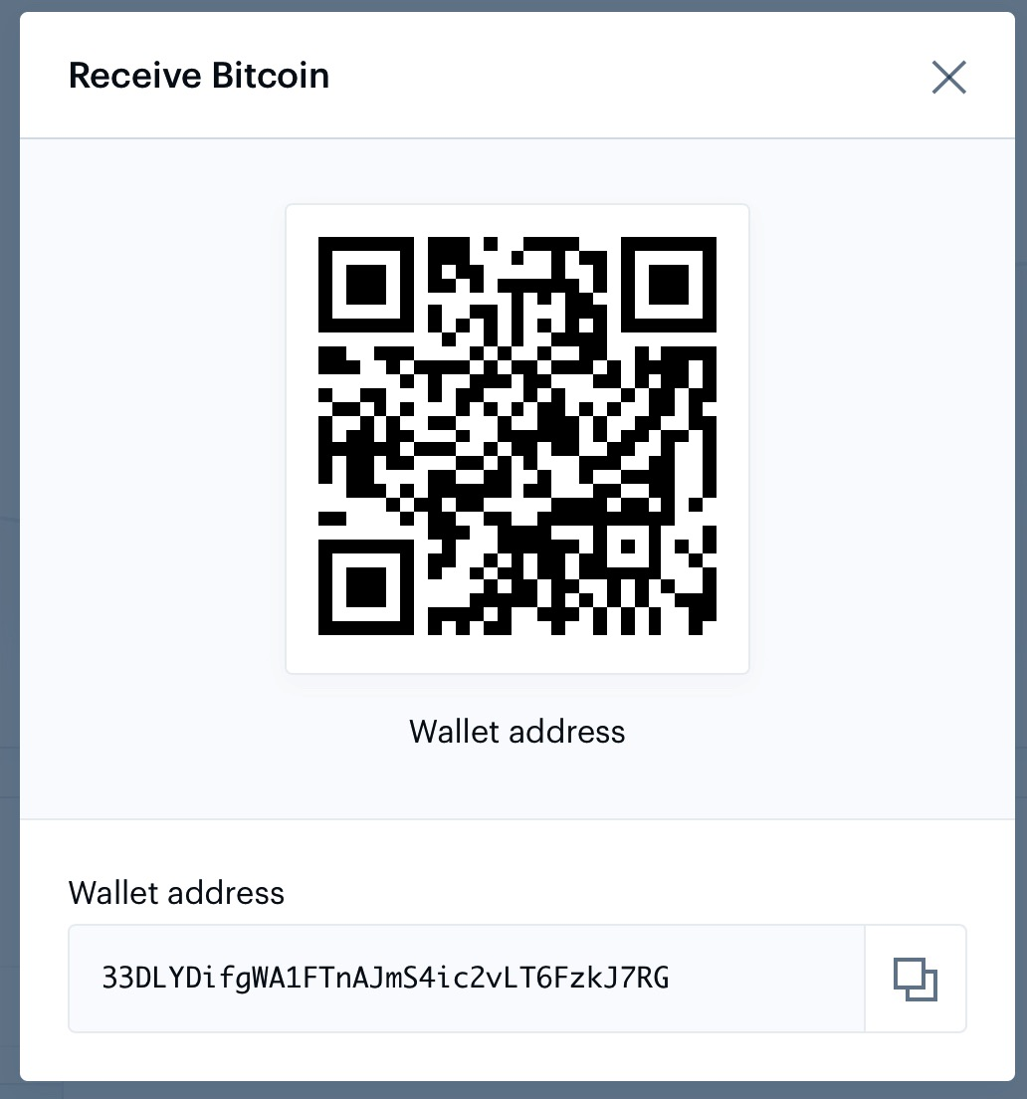
Encoding addresses

Slide 16
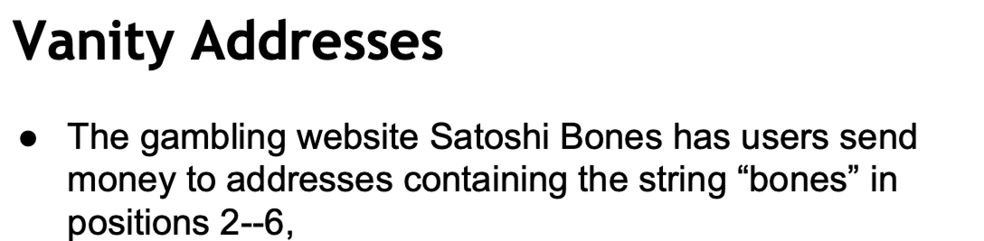

Slide 17
Hot and Cold Storage

Slide 18
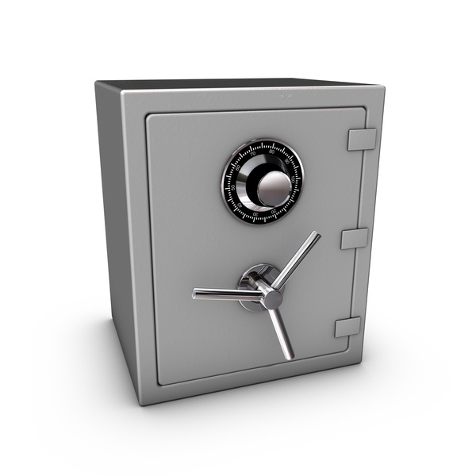
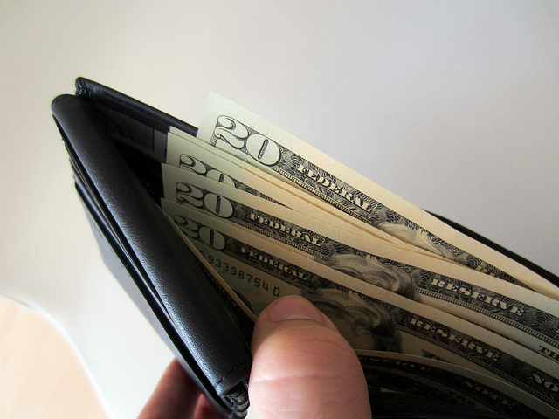
Hot storage
Cold storage
online
offline
convenient but risky
archival but safer
separate keys

Slide 19
Problem:
Want to use a new address (and key) for each coin sent to cold
But how can hot wallet learn new addresses if cold wallet is offline?
Awkward solution:
Generate a big batch of addresses/keys, transfer to hot beforehand
Better solution:
Hierarchical wallet

Slide 20
Regular key generation:
address
generateKeys
private key

Slide 21
Hierarchical key generation:
address
gen info
i^{th}
address
genAddr
i
generateKeysHier
i
private key
gen info
i^{th}
key
genKey

Slide 22
hot side
i
address
gen info
i^{th}
address
genAddr
generateKeysHier
private key
gen info
i^{th}
key
genKey
cold side
i

Slide 23
How to store cold info
(1) Info stored in device, device locked in a safe
(2) “Brain wallet” encrypt info under passphrase that user remembers
(3) Paper wallet print info on paper, lock up the paper
(4) In “tamperproof” device, device will sign things for you, but won’t divulge keys
Notes:
Highlight activity of stealing these

Slide 24
Online Wallets and Exchanges

Slide 25
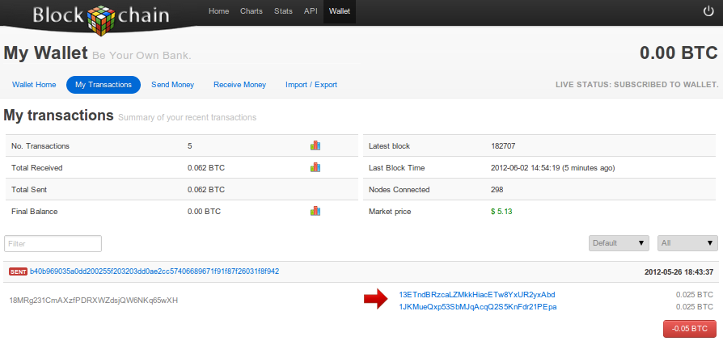
Online wallet
like a local wallet
but “in the cloud”
runs in your browser
site sends code
site stores keys
you log in to access wallet

Slide 26
Online wallet tradeoffs
convenient: nothing to install, works on multiple devices
but security worries - vulnerable if site is malicious or compromised
ideally, site is run by security professionals

Slide 27
Bank-like services
you give the bank money (a “deposit”)
bank promises to pay you back later, on demand
bank doesn’t actually keep your money in the back room
typically, bank invests the money
keeps some around to meet withdrawals (“fractional reserve”)

Slide 28
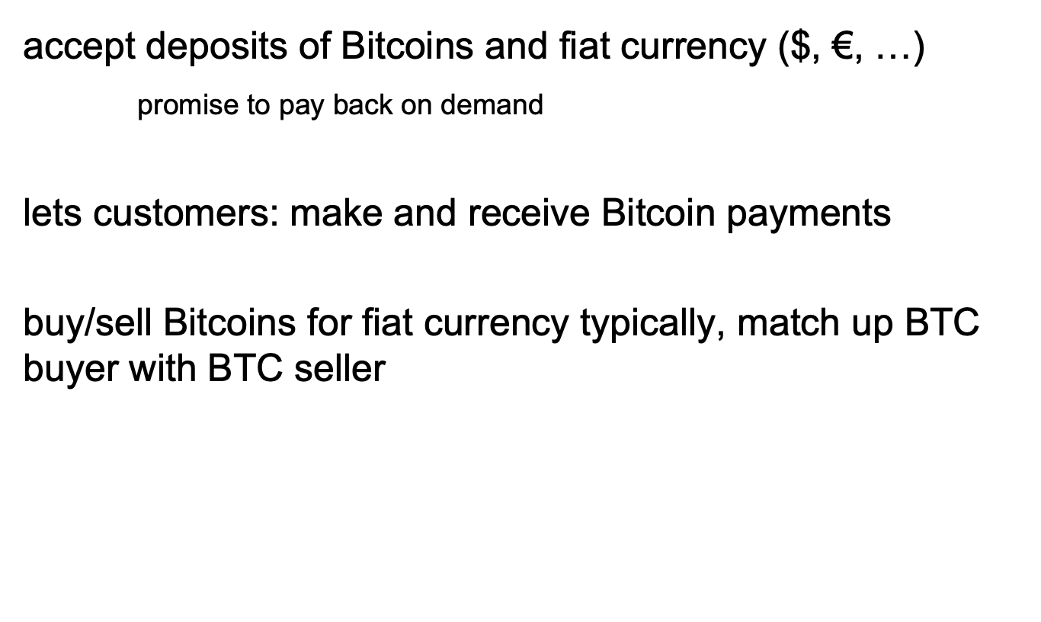
Bitcoin Exchanges

Slide 29
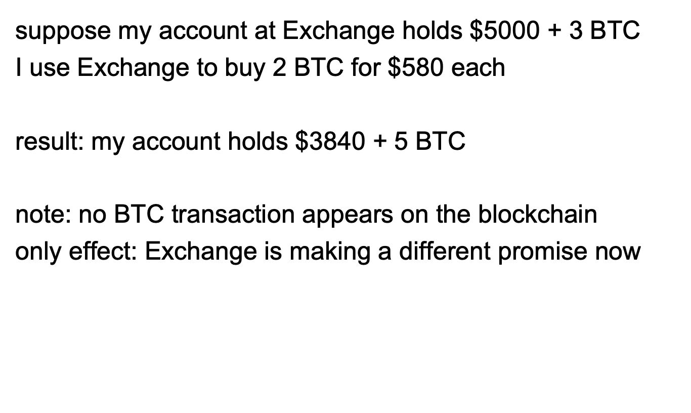
Buying BTC from an Exchange

Slide 30
Exchanges: Pros and Cons
pro: connects BTC economy to fiat currency economy
easy to transfer value back and forth
con: risk
same kinds of risks as banks

Slide 31
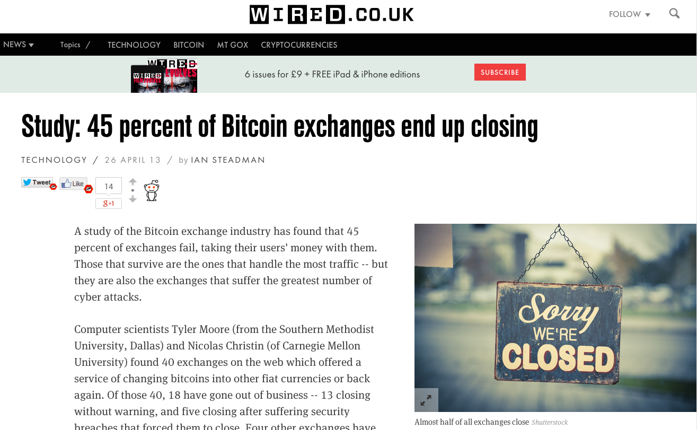

Slide 32
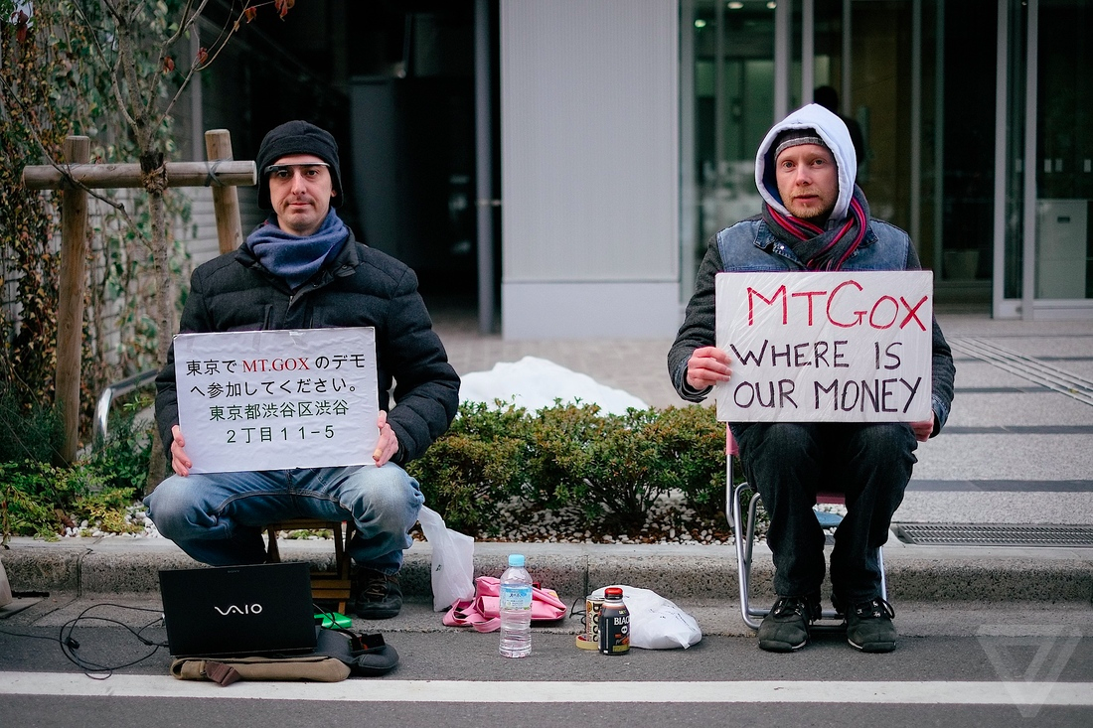
Notes:
Mt. Gox, short for "Magic: The Gathering Online Exchange," was one of the earliest and most well-known cryptocurrency exchanges, particularly for Bitcoin. It was launched in 2010 and quickly became one of the largest Bitcoin exchanges in the world, handling a significant portion of global Bitcoin trading. However, it is now infamous for its catastrophic collapse in 2014, which resulted in the loss of a vast amount of customers' Bitcoin and legal troubles for the exchange.
Here's an overview of Mt. Gox and its history:
1. **Founding and Early Success:** Mt. Gox was initially founded as an online platform for trading cards from the popular collectible card game "Magic: The Gathering." It later transitioned into a cryptocurrency exchange, initially facilitating the trade of Magic cards for Bitcoin and eventually becoming solely a Bitcoin exchange.
2. **Market Dominance:** At its peak, Mt. Gox was responsible for a significant portion of global Bitcoin trading volume and was widely considered the leading Bitcoin exchange. Its popularity grew as Bitcoin gained mainstream attention.
3. **Issues and Controversies:** As early as 2011, Mt. Gox experienced technical problems and security issues. It suspended Bitcoin withdrawals in early 2014, citing technical problems, which led to growing concerns among users.
4. **Collapse and Bankruptcy:** In February 2014, Mt. Gox abruptly halted all trading and filed for bankruptcy protection. It claimed to have lost 850,000 Bitcoins, valued at that time at hundreds of millions of dollars. The exact cause of the loss remains a subject of debate, with issues like hacking, mismanagement, and fraud all being suggested as contributing factors.
5. **Investigation and Legal Proceedings:** The collapse of Mt. Gox led to investigations and legal actions. The exchange's CEO, Mark Karpeles, faced charges in Japan related to the exchange's activities and management. In 2019, he was found guilty of falsifying financial records but was acquitted of embezzlement charges.
6. **Compensation for Users:** In an effort to compensate affected users, a trustee was appointed to oversee the distribution of any remaining assets. Some users have received a portion of their lost Bitcoin, although the recovery process has been complex and lengthy.
The Mt. Gox collapse had a significant impact on the cryptocurrency industry, leading to increased scrutiny and regulatory efforts. It also emphasized the importance of security and transparency in cryptocurrency exchanges. As a result, the industry has seen improvements in exchange practices, security, and regulatory compliance to reduce the risk of similar incidents in the future.

Slide 33
Bank Regulation
for traditional banks, government typically:
imposes minimum reserve requirements
must hold some fraction of deposits in reserve
regulates behavior, investments
insures depositors against losses
acts as lender of last resort
Notes:
Reserve requirement in the U.S. is typically 3-10%.

Slide 34
Proof of Reserve
Bitcoin exchange can prove it has fractional reserve.
fraction can be 100%
Prove how much reserve you’re holding:
publish valid payment-to-self of that amount

Slide 35
Payment Services

Slide 36
Scenario: merchant accepts BTC
customer wants: to pay with Bitcoin
merchant wants:
* to receive dollars
* simple deployment
* low risk (tech risk, security risk, exchange rate risk)

Slide 37
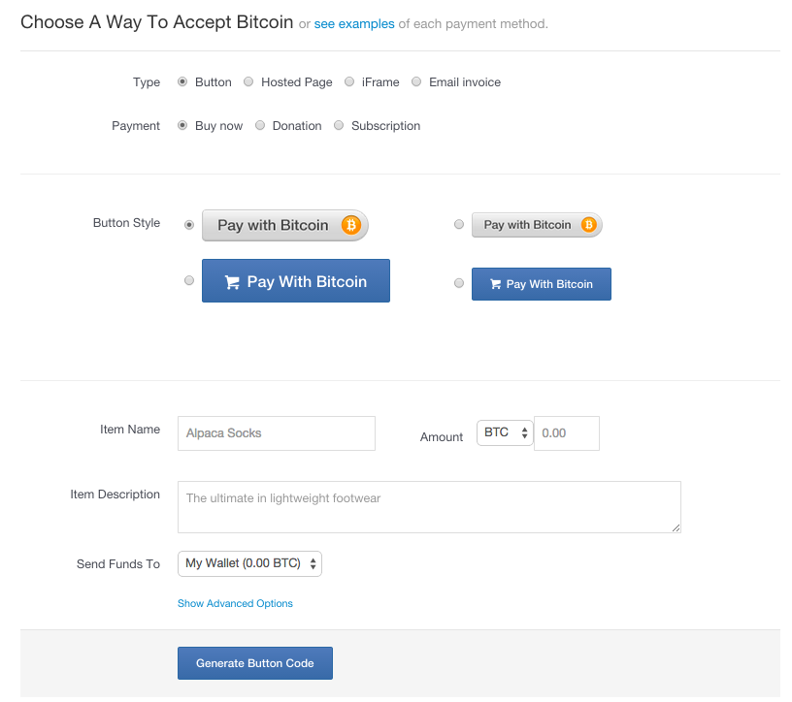
HTML for
payment button

Slide 38




payment
service
merchant
(5) confirm <transID, amount>
(4) redirect
(3) payment interaction
(4b) ok so far
(1) Pay with BTC button <transID, amount>
(2) clicked <transID, amount>
user

Slide 39
End result
customer: pays Bitcoins
merchant: gets dollars, minus a small percentage
payment service:
gets Bitcoins
pays dollars (keeps small percentage)
absorbs risk: security, exchange rate
needs to exchange Bitcoins for dollars, in volume

